Slide 1
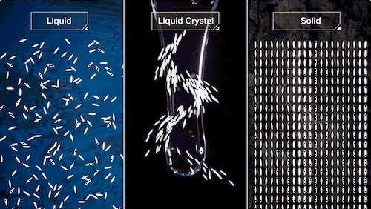
Liquid crystals: Classification, Properties and Applications

Slide 2
LIQUID CRYSTALS
Liquid Crystals are state of matter which has properties between those of conventional liquids and solid crystals. For example, a liquid crystal may flow like a liquid, but its molecules may be oriented in a crystal-like way.
The liquid-crystalline state is often called mesomorphic state (mezos meaning "intermediate"), and the liquid crystals are called mesophase.
Friedrich Reinitzer, Austrian botanist studied about it first in 1888 in a material known as cholesteryl benzoate .

Slide 3
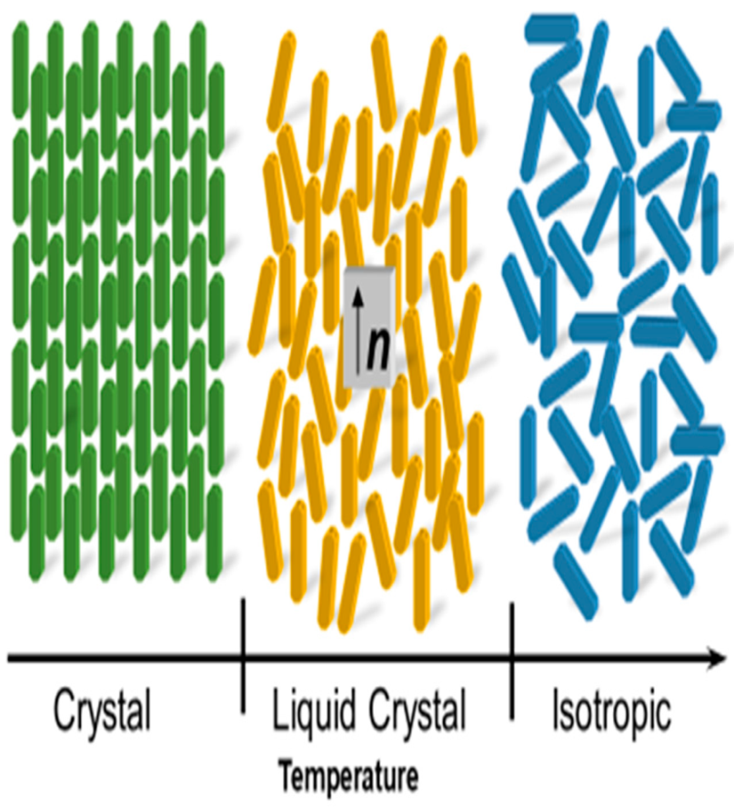
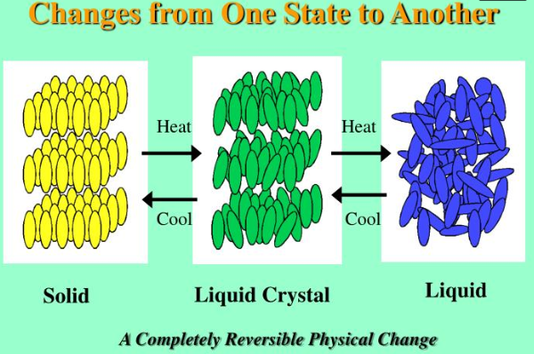

Slide 4
Following character describe the crystalline structure:
Positional order: the extent to which an average molecule or group of molecules shows translational symmetry (as crystalline material shows).
Orientational order: represents a measure of the tendency of the molecules to align along the directon on a long-range basis.

Slide 5
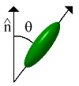
Bond Orientational Order: describes a line joining the centres of nearest neighbour molecules without requiring a regular spacing along that line.
Positional order + Orientational order = crystal phase
Varying Positional order + Orientational order = LC phase

Slide 6
Positional order + Orientational order = Crystal Phase
Positional order + No Orientational order = Plastic Phase
Varying Positional order + Orientational order = Liquid crystalline Phase
No positional order + No Orientational order = Isotropic (Liquid) Phase

Slide 7
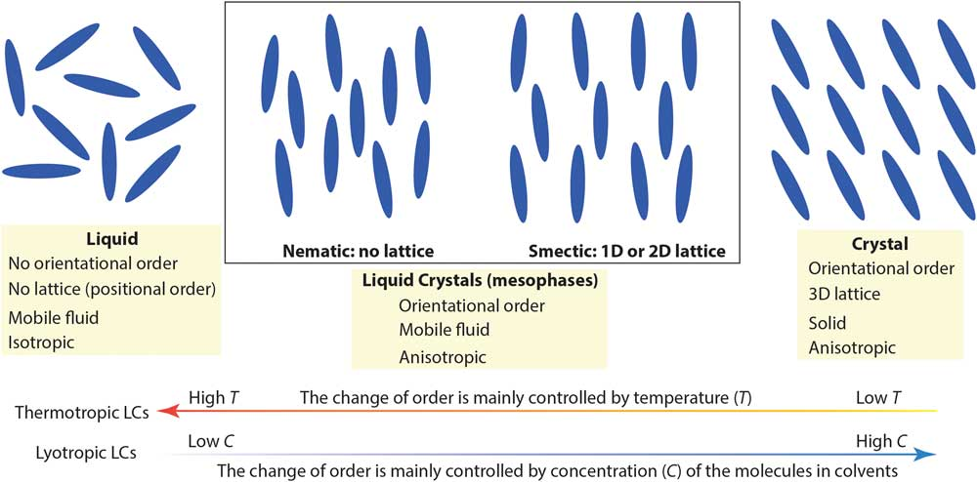

Slide 8
Properties of liquid crystals
The molecules are rod shaped or disc shaped.
All liquid crystals are mesogens but all mesogens are not liquid crystals.
Molecules are anisotropic in nature.
Assuming that the direction of preferred orientation in a liquid crystal (LC) is ↑, this direction can be represented by an arrow, called the director of the LC.

Slide 9
Each molecule is orientated at some angle to the director.
These molecules possess very strong dipole moment.
The liquid crystal molecules prefer to align parallel to each other because of the strong intermolecular attraction (π-π interaction).
A typical Liquid Crystal molecule is represented by a central rigid part, known as mesogen (generally aromatic) and the flexible ends (generally aliphatic groups).

Slide 10
long range order and short range order
Crystalline solids have a long range order which means that there is a regular pattern of arrangement of particles which repeats itself periodically over the entire crystal. Whereas, amorphous solids consist of particles of irregular shape and have short range order only.
Aanisotropy
Anisotropy is the property of being directionally dependent, as opposed to isotropy (homogeneity in all directions). It can be defined as a difference in the physical property of a certain material when measured along different axes.
For example many materials exhibit very different properties when measured along different axes: physical or mechanical properties (absorbance, refractive index, conductivity, tensile strength, etc.)

Slide 11
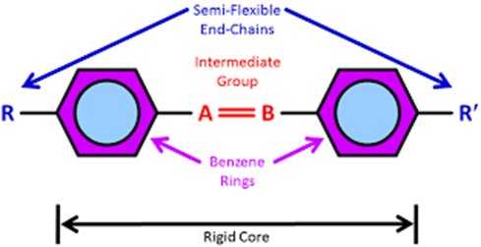
It consists of two or more ring systems connected by a central linkage group.

Slide 12
Essential requirements for a molecule to be a liquid crystal
Shape of the molecule must be rod like or disc like.
Molecule must be anisotropic in nature.
Molecule must have some rigidity in its central region and the ends must be flexible.
Although LC’s combine the properties of a crystalline solid and an isotropic liquid, they exhibit very specific electro-optical phenomena, which have no equivalent analogues in solids or in liquids.

Slide 13
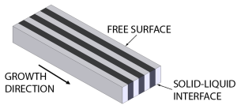
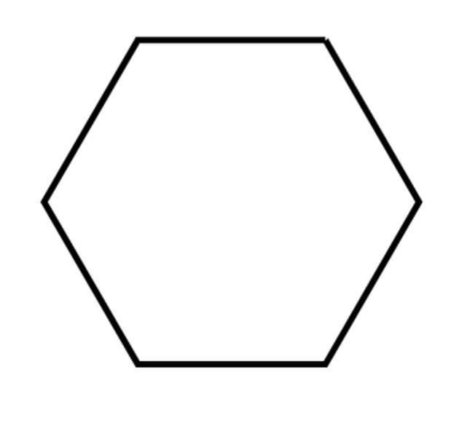
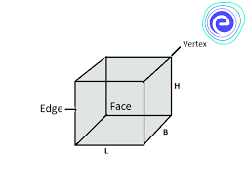
Classification of liquid crystals:
Liquid Crystals
Thermotropic L.C.
(Temperature dependent)
Lyotropic L.C.
(Solvent dependent)
Calamatic L.C.
(Rod shaped)
Discotic L.C.
(Disc Shaped)
Lamellar
Hexagonal
Cubic
Smectic L.C.
Nematic L.C.
Discotic Nematic
Discotic Columnar
Smectic A
Smectic C
Ordinary Nematic
Nematic Cholesteric

Slide 14
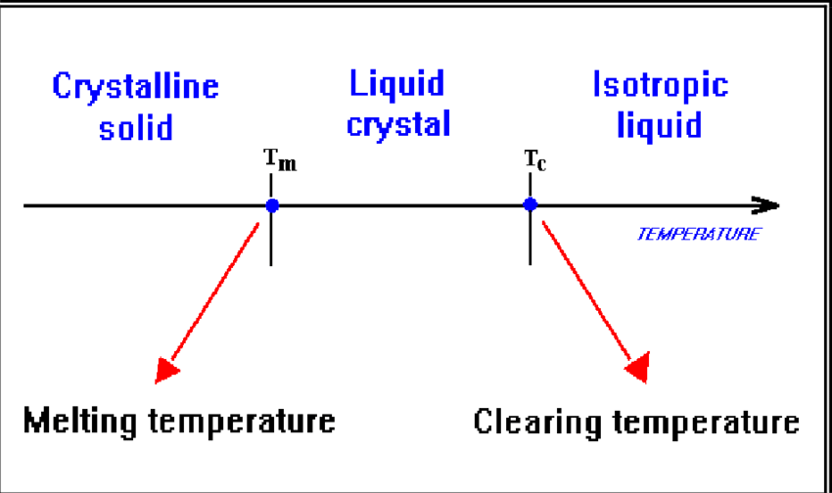
1. Thermotropic liquid crystals:
They are formed by change of temperature. They occur as liquid crystals over a certain temperature range between the solid and liquid phase. Example – LCD TV’s, alarm clocks.

Slide 15
Examples of Thermotropic LCs:
Compound | Transition temperature (°C) | Melting Temperature (°C)
p-azoxy anisole | 116 | 135
p-methoxy cinnamic acid | 170 | 186
Dibenzal benzidine | 235 | 260
Types of Thermotropic LCs:- Nematic, Sematic, Chiral.

Slide 16
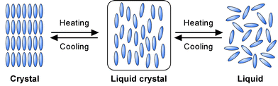
Thermotropic liquid crystals are further classified into:
a) Calamatic L.C.(Rod like or elongated molecules)
b) Discotic Liquid Crystals (Disc shape molecules)
Calamatic liquid crystals are elongated, rod shaped molecules. They are further classified as Nematic and Smectic liquid crystals.

Slide 17
Nematic liquid crystals
Word Nematic derived from Greek word Nema which means "thread".
No positional order, but possess orientational order.
Molecule have elongated rod like shape and are thread like.
Do not have layered structure.
Flow like normal liquids.
They have low viscosity.
Formed at relatively higher temperature.

Slide 18
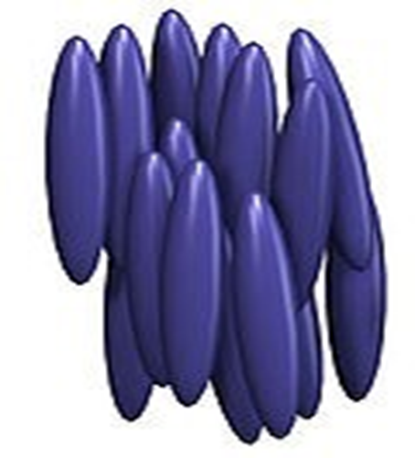
Can be aligned by the application of electric on magnetic field.
Molecules are free to move in all the directions.
Flow in all directions & not in layers.
E.g.- p-azoxy anisole (first synthetic liquid crystal to be produced).

Slide 19
Nematic liquid crystals can be further classified as:
a) Ordinary nematic phases: These molecules possess ordinary nematic phase characteristics as discussed earlier.
b) Cholesteric nematic phases: This phase is also known as chiral nematic phase. The molecules are essentially chiral and resembles nematic molecules in nature.

Slide 20
Cholesteric Liquid Crystals (Chiral Nematic)
This phase is usually observed from cholesterol derivatives.
The molecules are essentially chiral.
The molecules are arranged in layers.
These are formed by adding chiral twisting agent to the nematic liquid crystals.

Slide 21
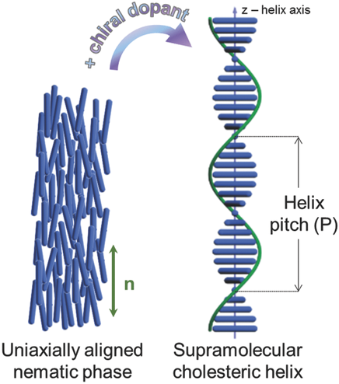

Slide 22
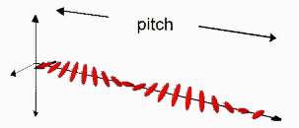
Each layer in Cholesteric liquid crystal is tilted with respect to the other one, and hence the molecules take a one complete turn of 360 degrees to make a helix.
The distance covered by the director in making a one complete turn is known as pitch.

Slide 23
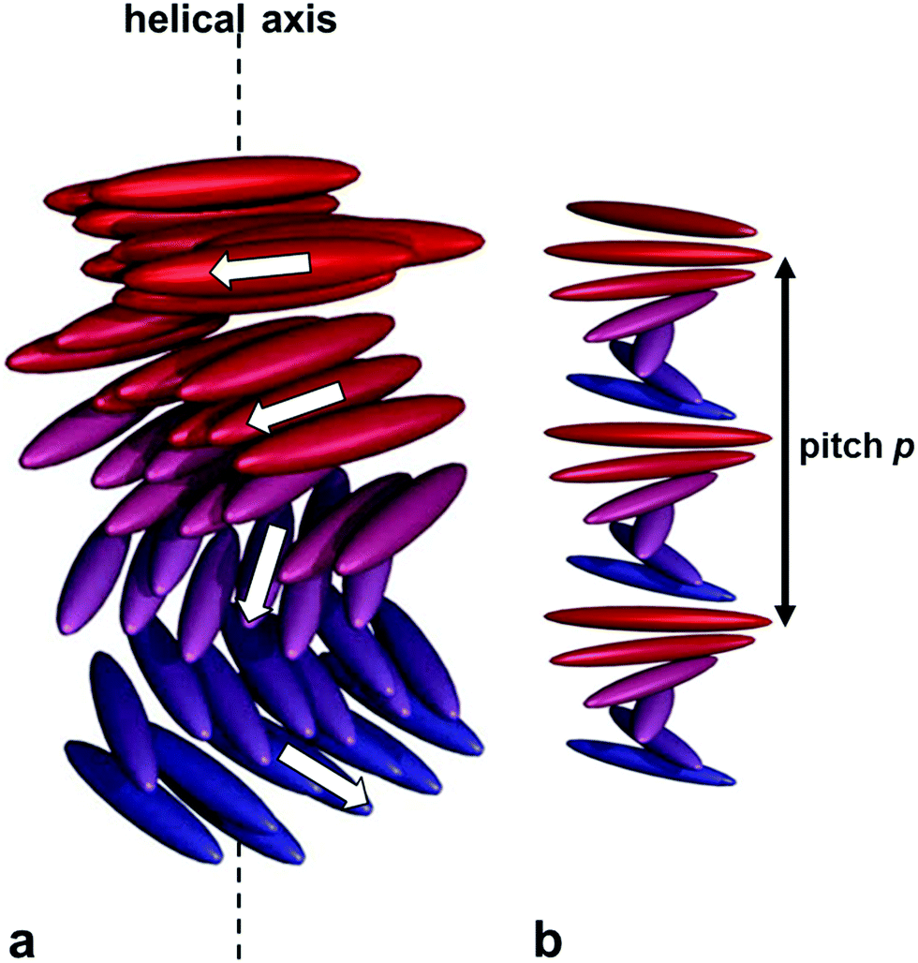
Cholesteric Liquid crystal reflects light approximately equal to pitch.
Pitch is inversely proportional to the temperature.
Pitch is affected by temperature, pressure as well as by electric and magnetic fields.

Slide 24
Smectic Liquid Crystals:
Molecules are soap shaped.
Have short range orientational as well as positional order.
These are arranged in layers i.e. have layered structure.
They do not flow like normal liquids and has limited mobility.
They have high viscosity.
Not affected by external electric or magnetic field.

Slide 25
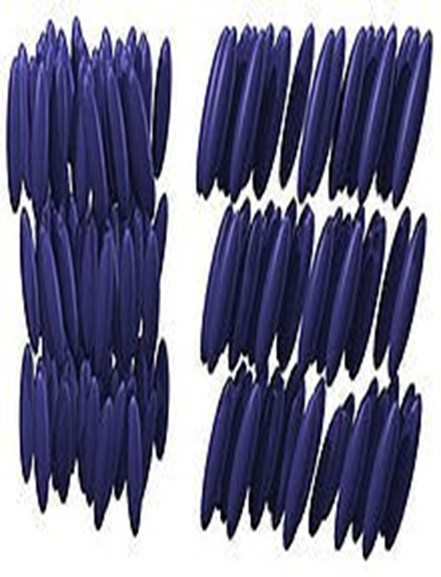
Molecules are free to move within the layers, but not from one layer to another.
Flow in layers and difference layers can slide over one another.
Are of two types: Smectic A and C.
E.g.: Ethyl-para-azoxy phenetole.

Slide 26
Discotic Liquid Crystals:
Molecules are essentially disc shaped.
Discotic mesogens are typically composed of an aromatic core surrounded by flexible alkyl chains. The aromatic cores allow charge transfer in the stacking direction through the π conjugate systems. The charge transfer allows the discotic liquid crystals to be electrically semi conductive along the stacking direction.
They are of two types: Discotic nematic Phase and Columnar Phase.

Slide 27
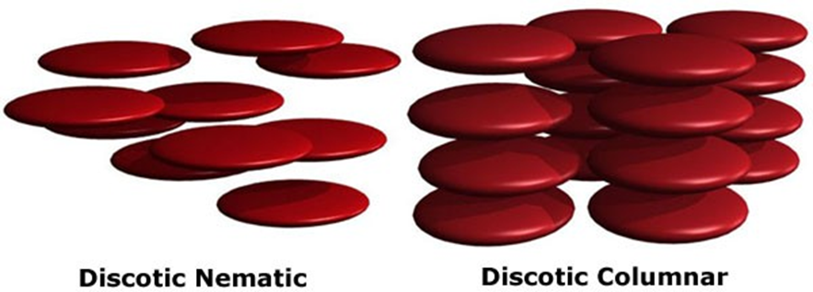
Disc-shaped molecules have a tendency to lie on top of one another forming either discotic nematic phases (with discs oriented similar to that of nematic phase i.e. not having position order but having orientation order) or columnar phases (have column-like structure).

Slide 28
Lyotropic Liquid Crystals:
Lyotropic liquid crystals are two component systems, where an amphiphile is dissolved in a solvent.
Thus, lyotropic mesophases are solvent and concentration dependent.
The amphiphillic compounds are characterized by two different moieties, a hydrophilic polar head and a hydrophobic tail.

Slide 29
LLC are made by adding solvent to the solid until critical micelle concentration (CMC) is reached. On further addition of solvent LLC changes into liquid phase.
Examples: molecules of soaps, phospholipids (present in cell membranes), toothpaste, many proteins and cell membranes, tobacco mosaic virus.

Slide 30
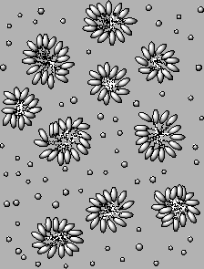
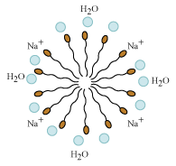
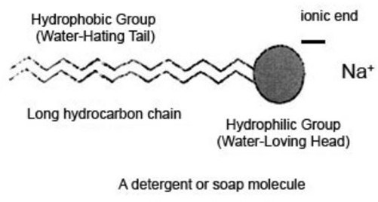

Slide 31
Three types of lyotropic liquid crystals are well known. These are: lamellar, hexagonal and cubic phases.
i) The simplest liquid crystalline phase that is formed by spherical micelles is the ‘micellar cubic’, denoted by the symbol I₁. This is a highly viscous, optically isotropic phase in which the micelles are arranged on a cubic lattice.
ii) At higher amphiphile concentrations the micelles fuse to form cylindrical aggregates of indefinite length, and these cylinders are arranged on a long-ranged hexagonal lattice. This lyotropic liquid crystalline phase is known as the ‘hexagonal phase’, and is generally denoted by the symbol HI.

Slide 32
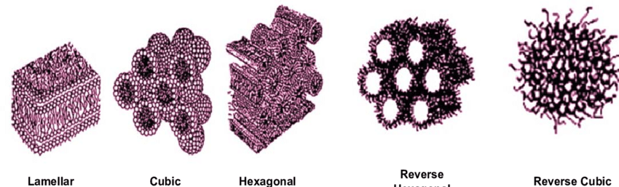
iii) At higher concentrations of amphiphile the ‘Lamellar Phase' is formed. This phase is denoted by the symbol L_{α}. This phase consists of amphiphilic molecules are arranged in bilayer sheets separated by layers of water.

Slide 33
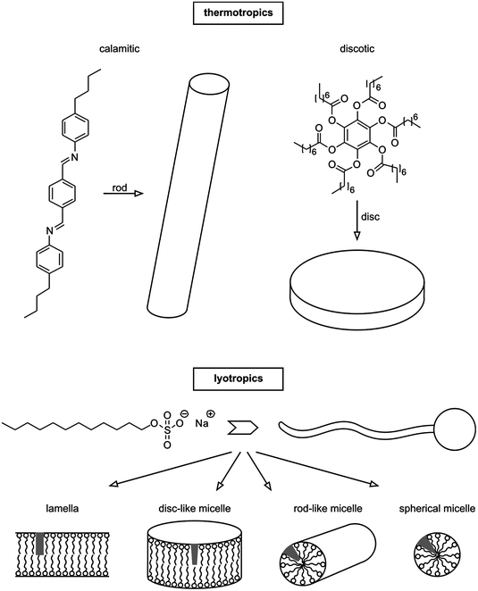

Slide 34
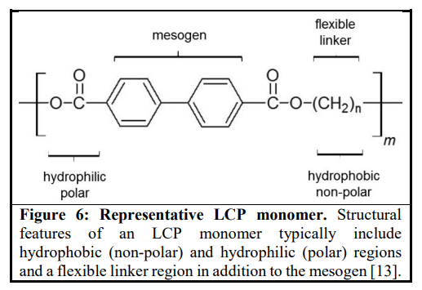
Liquid Crystal Polymers (LCPs)
Liquid crystal polymers (LCPs) consist of repeated monomer units but which are linked to form extended chain-like molecules. The primary units of the polymeric chain are attached to one another via a flexible linker which can be of varying lengths (Fig). These polymeric chains aggregate to form LCPs just as single mesogen molecules do to form liquid crystals. The extended chain length of the polymeric units, however, affects enhanced intermolecular interactions between the polymeric chains and thus has profound effects upon LCP behavior distinct from simple (nonpolymeric) liquid crystals.

Slide 35
Liquid Crystal Polymers (LCPs)
Polymer liquid crystals (PLCs) are a class of materials that combine the properties of polymers with those of liquid crystals.
These “hybrids” show the same mesophases characteristic of ordinary liquid crystals, yet retain many of the useful and versatile properties of polymers.
Types of liquid crystal polymers;
Main chain liquid crystal polymers (MCLCPs)
Side chain liquid crystal polymers (SCLCPs)

Slide 36
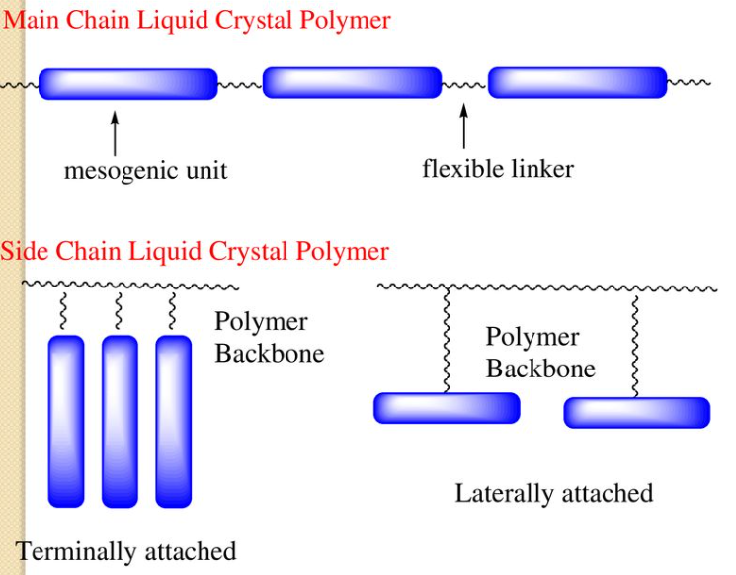
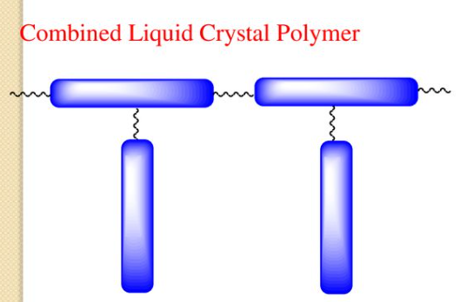
Main-chain polymer liquid crystals or MC-PLCs are formed when the mesogens are themselves part of the main chain of a polymer.
Side chain polymer liquid crystals or SC-PLCs are formed when the mesogens are connected as side chains to the polymer by a flexible "bridge" (called the spacer.)

Slide 37
Applications of liquid crystals:
Liquid crystals are used for decorative purpose in cosmetics.
LC’s based delivery system such as cream, ointment, transdermal patches etc have been used in pharmaceutical.
Thermotropic Cholesteric liquid crystals are used in body care cosmetics.
Due to their colour effect Cholesteric liquid crystals are used in nail paints, eye shadows etc.
Discotic liquid crystals are used in photovoltaic devices, organic light emitting diodes (OLED), and molecular wires.

Slide 38
Liquid crystals are used for displays in LCD's, Calculator, wrist watches etc.
Have Medical applications like localized drug delivery.
To detect radiations& pollutants in atmosphere.
Used in non-destructive testing.
Cholesteric liquid crystals are used in coloured thermometers.
Used to locate tumours, veins, arteries, infections, foetal placenta etc.

Slide 39
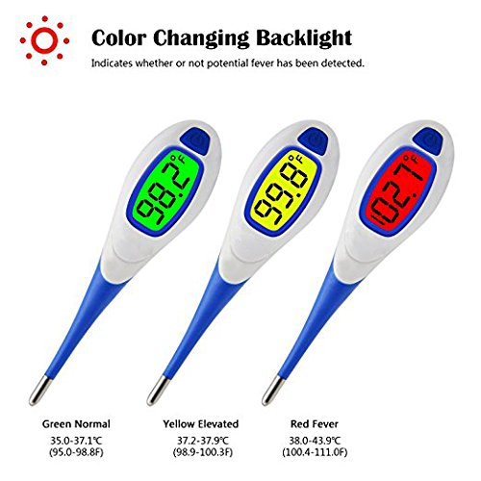
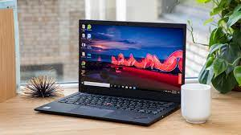
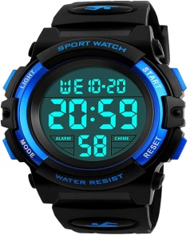
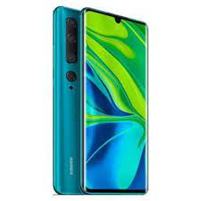

Slide 40
Liquid Crystal and Its Applications
Liquid crystals are a unique state of matter that exhibit properties of both liquids and solids. They have a distinct molecular arrangement that allows them to flow like a liquid while maintaining some degree of order like a solid. This unique behavior makes them useful in various applications. Here are some common applications of liquid crystals:
Liquid Crystal Displays (LCDs): LCDs are widely used in electronic devices such as televisions, computer monitors, smartphones, and digital watches. In LCDs, liquid crystals are sandwiched between two glass plates and controlled by an electric field. By manipulating the alignment of liquid crystal molecules, LCDs can selectively block or allow light to pass through, creating images or text.
Optical Devices: Liquid crystals are used in various optical devices, including polarizers, optical shutters, and variable optical attenuators. By applying an electric field, the orientation of liquid crystal molecules can be controlled, allowing the manipulation of light polarization, transmission, and intensity.
Thermometers: Liquid crystals can be used in thermometers to indicate temperature changes. The liquid crystal material changes color at specific temperature ranges, providing a visual indication of the temperature.
Smart Windows: Liquid crystals can be incorporated into windows to control the amount of light and heat passing through. By applying an electric field, the transparency of the liquid crystal layer can be adjusted, allowing for the regulation of light and heat transmission.

Slide 41
Liquid Crystal and Its Applications
Biomedical Applications: Liquid crystals have been used in various biomedical applications, including drug delivery systems, biosensors, and tissue engineering. They can be used to encapsulate and release drugs at specific locations, detect biological molecules, and provide scaffolds for tissue growth.
Electro-Optical Devices: Liquid crystals are used in electro-optical devices such as modulators, switches, and beam deflectors. By applying an electric field, the refractive index of liquid crystals can be changed, allowing for the manipulation of light propagation and beam steering.
These are just a few examples of the wide range of applications of liquid crystals. Their unique properties make them versatile materials in various fields, including electronics, optics, thermodynamics, and biomedicine.

Slide 42
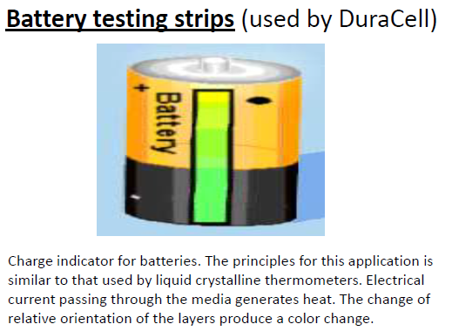

Slide 43
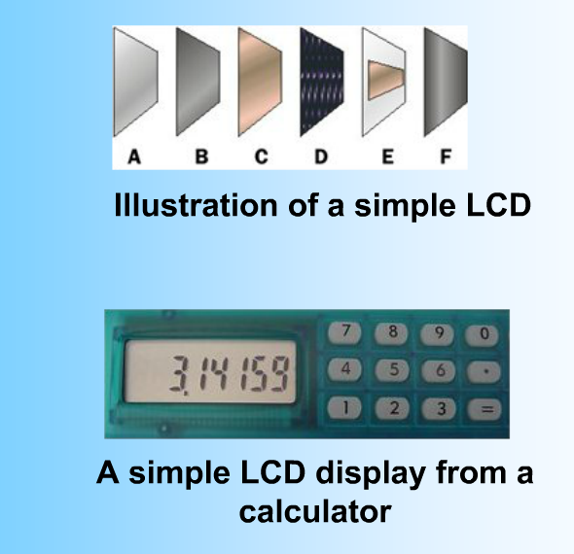
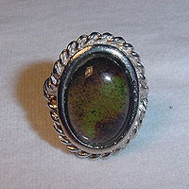
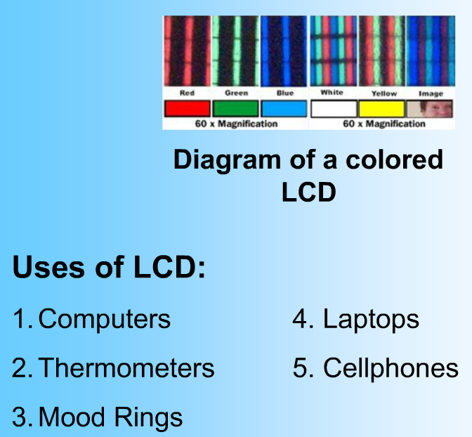

Slide 44
Liquid-crystal display (LCD)
LCD is a flat-panel display or other electronically modulated optical device that uses the light-modulating properties of liquid crystals combined with polarizers.
Liquid crystals do not emit light directly but instead use a backlight or reflector to produce images in color or monochrome. LCDs are available to display arbitrary images or fixed images with low information content, which can be displayed or hidden.
They use the same basic technology, except that arbitrary images are made from a matrix of small pixels, while other displays have larger elements. LCDs can either be normally on (positive) or off (negative), depending on the polarizer arrangement.
For example, a character positive LCD with a backlight will have black lettering on a background that is the color of the backlight, and a character negative LCD will have a black background with the letters being of the same color as the backlight. Optical filters are added to white on blue LCDs to give them their characteristic appearance.
LCDs are used in a wide range of applications, including LCD televisions, computer monitors, instrument panels, aircraft cockpit displays, and indoor and outdoor signage.
Small LCD screens are common in LCD projectors and portable consumer devices such as digital cameras, watches, calculators, and mobile telephones, including smartphones. LCD screens have replaced heavy, bulky and less energy-efficient cathode-ray tube (CRT) displays in nearly all applications.

Slide 45
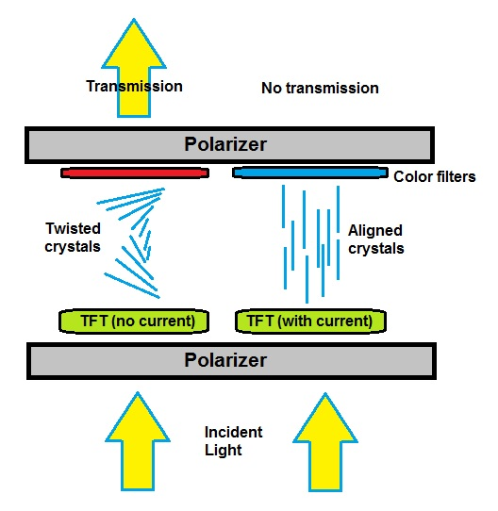
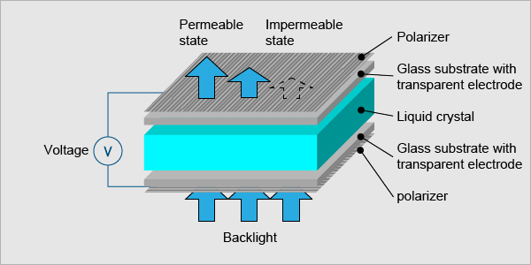
Liquid-crystal display (LCD)

Slide 46
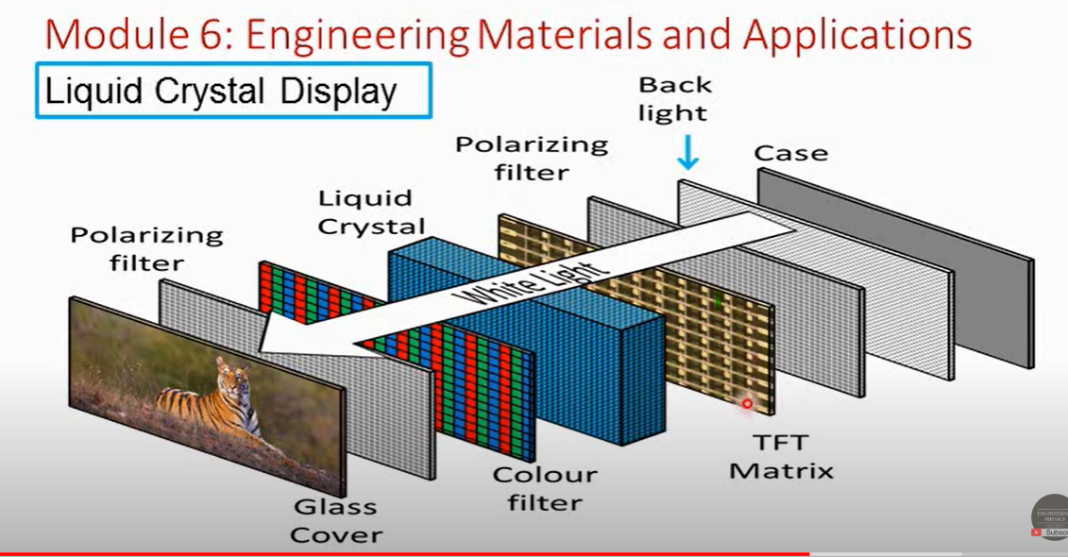
https://www.youtube.com/watch?v=F0aeFniieB8&list=PPSV
https://www.youtube.com/watch?v=Gt0vRVVlV-I&list=PPSV
TFT is Thin Film Transistor. It is a display screen technique used in LCD (liquid crystal display)

Slide 47
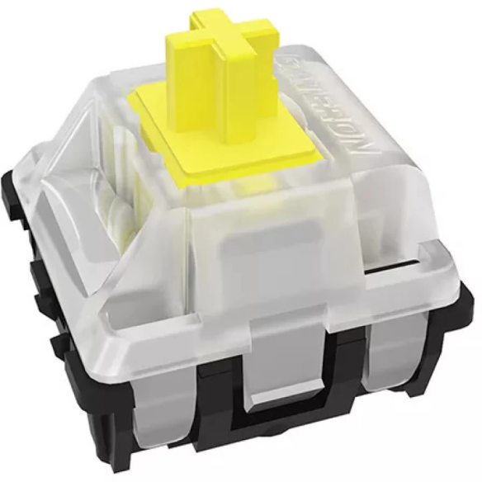
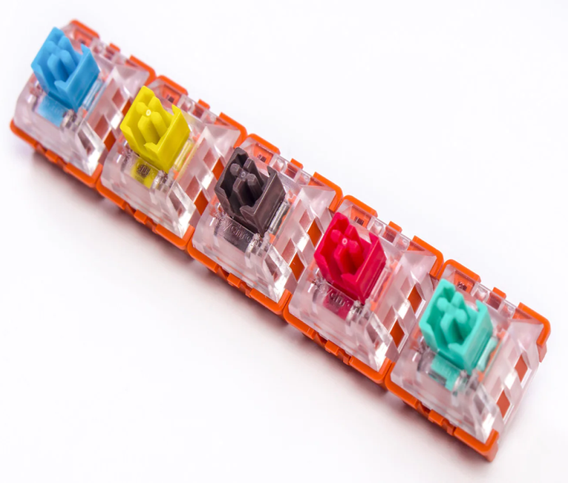

Applications of LCs in optical switches
What Is Optical Switch?
An optical switch is a multi-port network bridge, which connects multiple optic fibers to each other and controls data packets routing between inputs and outputs. Some optical switches convert light to electrical data before forwarding it and converting it into a light signal again.
Allows one optical signal to control another optical signal that is control of light by light.
As the name implies, the optical switch uses light induction to trigger the switches. The most direct understanding of optical switch is a device used to open or close an optical circuit. It consists of mechanical, optomechanical, or electronic types.
It works with the mechanical switch to block the light beam. When the switch is pressed, the stem of the switch moves downward, triggering the light sensor on the PCB (Printed Circuit Board) and activating the key.
That’s why optical switches are faster than the traditional switch as no physical contact is needed to send an electrical signal; eliminating the need for a debounce delay. Also, because there is no physical contact, these switches are usually more durable.
The lifespan of the traditional switch is 50 million key presses while the optical switch can double that life span and can last 100 million.

Slide 48
Applications of LCs in optical switches
In the past few years, LC cells appear as one of the promising technologies to achieve optical switching in telecommunications networks as these devices do not need moving parts to switch, but a control voltage. Also, optical switching employs liquid crystal (LC) materials due to their extreme sensitivity to applied fields, low power consumption, long lifetime and to their low cost.
Optical switches are based on twisted nematic (TN) LCs and surface-stabilized ferroelectric liquid crystals (SSFLC). More recently, systems based on polymer-dispersed liquid crystal (PDLC) have also been developed.

Slide 49
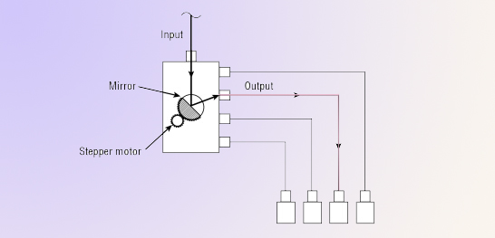
How Does Optical Switch Work
The optical switch is a technology that operates on fiber optic circuit to work similar to traditional electrical network switches. The optical switch we mainly mentioned here is operated by mechanical means which physically move fiber or other bulk optic elements. For example, the opto-mechanical switch redirected an optical signal by moving fiber by means of a mechanical device are typically stepper motor driven. It move a mirror(prisms, or directional couplers) that directs the light from the input to the desired output.

Slide 50
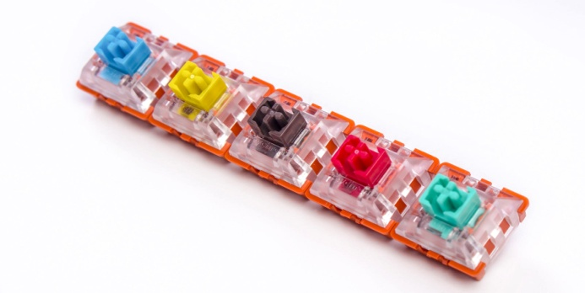
Why choose the optical switches?
Here are some advantages optical switches offer:
1. Optical switches have a faster and more sensitive trigger response.
Since optical switches are triggered by the acceptance of optical, as long as the displacement blocks the optical, it can produce a signal. So at a microscopic level, optical switches will respond faster than mechanical switches. In situations that require a high degree of low latency, such as gaming, for example, optical switches will offer a faster response rate.
2. Optical switches have a longer life span
When mechanical switches experience problems, it generally is related to problems with the foot pin or the flake trigger. With optical switches, they don’t have these problems because they’re triggered by light signal. As a result, optical switches is more durable and can last longer with over 100 million clicks lifespan. The mechanical switches normally have 50 million clicks lifespan.

Slide 51
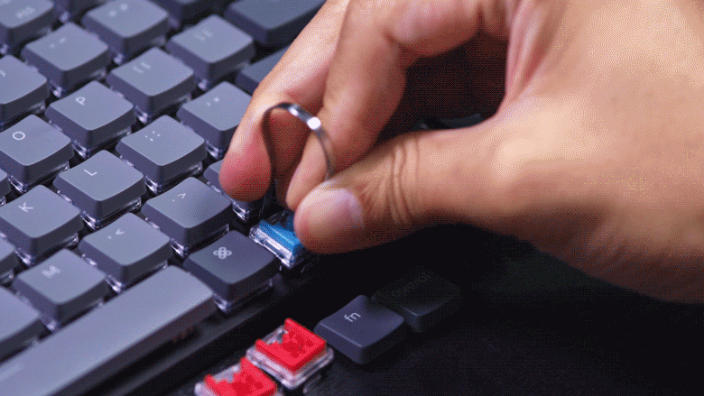
3. Optical switches are easier to replace
An optical switch, as long as it’s the same model, can be easily replaced.
Mechanical switches on keyboards, if they’re not hot-swappable, need to be soldered in order to replace the switch. For ease of customization, the optical switches are more convenient.

Slide 52
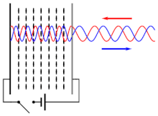
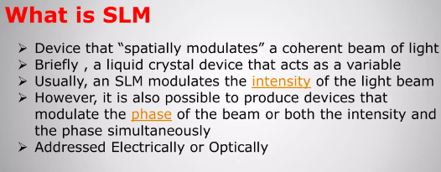
Spatial Light Modulators
Spatial light modulator (SLM) is an optical device that imposes some form of spatially varying modulation on a beam of light. A simple example is an overhead projector transparency. Usually when the term SLM is used, it means that the transparency can be controlled by a computer. In the 1980s, large SLMs were placed on overhead projectors to project computer monitor contents to the screen. Since then, more modern projectors have been developed where the SLM is built inside the projector. These are commonly used in meetings for presentations.
Usually, an SLM modulates the intensity of the light beam. However, it is also possible to produce devices that modulate the phase of the beam or both the intensity and the phase simultaneously.
SLMs are used extensively in holographic data storage setups to encode information into a laser beam similarly to the way a transparency does for an overhead projector. They can also be used as part of a holographic display technology.
SLMs have been used as a component in optical computing. They also often find application in holographic optical tweezers.
Liquid crystal SLMs can help solve problems related to laser microparticle manipulation. In this case spiral beam parameters can be changed dynamically
Schematic of liquid crystal-based Spatial Light Modulator. As liquid crystals are birefringent, applying a voltage to the cell changes the effective refractive index seen by the incident wave, and thus the phase retardation of the reflected wave.

Slide 53
Spatial Light Modulators
A spatial light modulator is a device that modulates the spatial distribution of light waves. Generally speaking, the spatial light modulator is composed of many independent units, which are arranged into one-dimensional or two-dimensional array structures in space. Each unit independently receives the control of optical signal or electrical signal, and changes the amplitude or intensity, phase, and polarization of light received in space.
According to the different addressing modes of the spatial light modulator, it can be divided into electrical addressing spatial light modulator (EA-SLM) and optical addressing spatial light modulator (OA-SLM).
Due to the rapid developments in liquid crystal technology, the application of electrically addressable liquid crystal spatial light modulators as wavefront correction devices has attracted more and more attention. As a result, electrically addressable LC-SLM has great potential in realizing high-resolution wavefront control of optical systems.

Slide 54
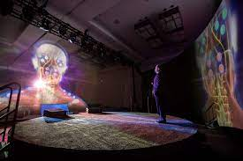
Holographic display
A holographic display is a type of 3D display that utilizes light diffraction to display a three-dimensional image to the viewer. Holographic displays are distinguished from other forms of 3D displays in that they do not require the viewer to wear any special glasses or use external equipment to be able to see the image, and do not cause the vergence-accommodation conflict.
In simple terms, hologram technology is a three-dimensional projection which can be seen without using any special equipment such as cameras or glasses. The image can be viewed from any angle, so as the user walks around the display the object will appear to move and shift realistically. Holographic images can be static, such as a picture of a product, or they may be animated sequences which can be watched by multiple people from any viewpoint.
Some commercially available 3D displays are advertised as being holographic

Slide 55
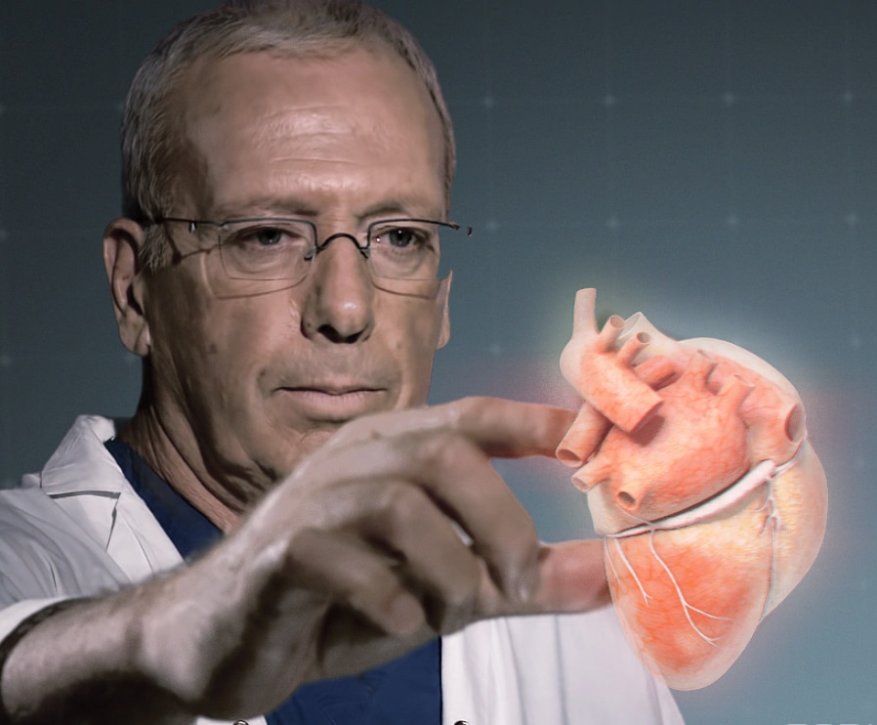
Applications of Holography
In healthcare industry
Doctors and patients alike will benefit from radical new applications of holograms in the medical industry. The type of data provided by modern imaging techniques such as MRI and CAT scans can be easily translated into digital information. Traditionally, doctors have viewed this data on computer screens in 2D slices. Medical hologram technology will allow a complete 3D visualisation of internal organs and body parts. This will allow doctors a greater ability to examine diseases and injuries in individual patients and will lead to more accurate diagnoses.

Slide 56
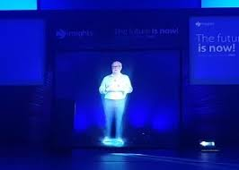
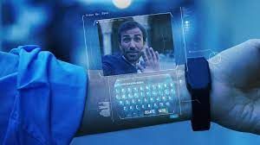
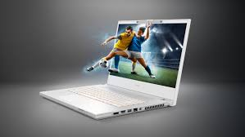
Applications of Holography
Holographic entertainment is no longer simply a science fiction dream. One of the most visible applications of this technology in recent years has been its use in concerts. Stars from the past can be resurrected to perform once again, and even accompany modern artists live on stage.
These displays can also be used for live performances where the musicians are not physically present, instead transmitting their image to appear before the audience.
Acer Laptop With Holographic Display
Holographic Projection and Virtual Reality
Video Production
Mobile Holographic Display

Slide 57
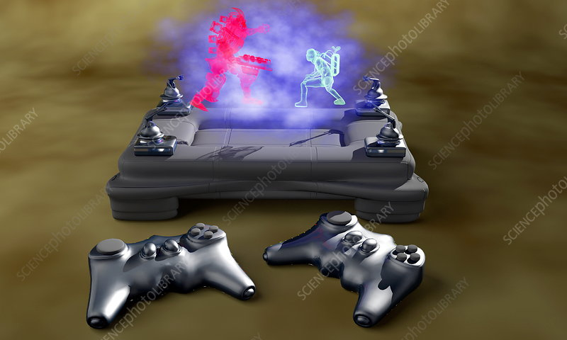
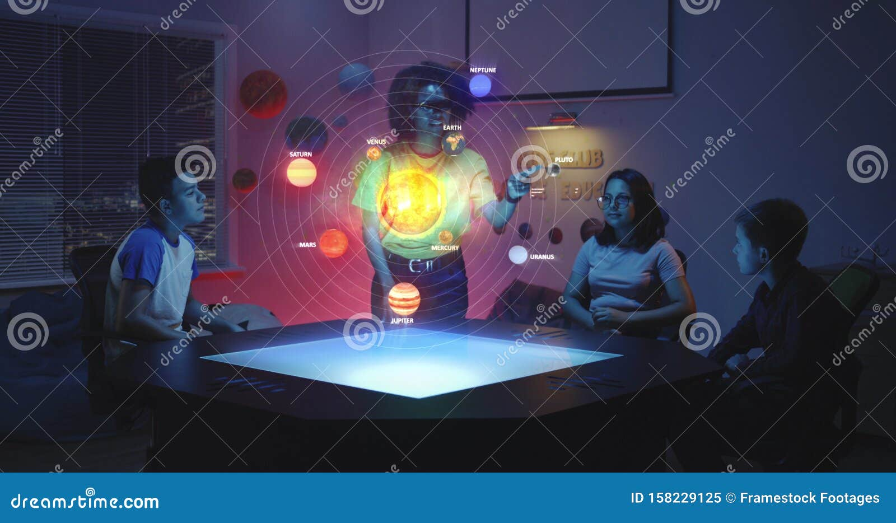
Applications of Holography
In gaming
In the area of gaming, holographic technology is being used by developers to create realistic characters. Surrounding a subject with cameras and sensors allows the developers to capture photorealistic models which then appear in their games. The cameras take shots of the subject from lots of angles, which means the models that appear in the game are fully 3D and interactive.
In the classroom
One of the most exciting applications of holograms is the improvement of the educational experience. In order to engage students more fully, interactive digital lessons will be used in schools. This combination of digital and real-world information is known as mixed reality.
Complex subjects can be taught using holographic images that students can interact with and examine. For example, pupils can virtually explore the ruins of an ancient building during history lessons, or observe individual atomic particles and how they behave.

